Slide 1
The software life cycle 302
Chapter 7.2

Slide 2
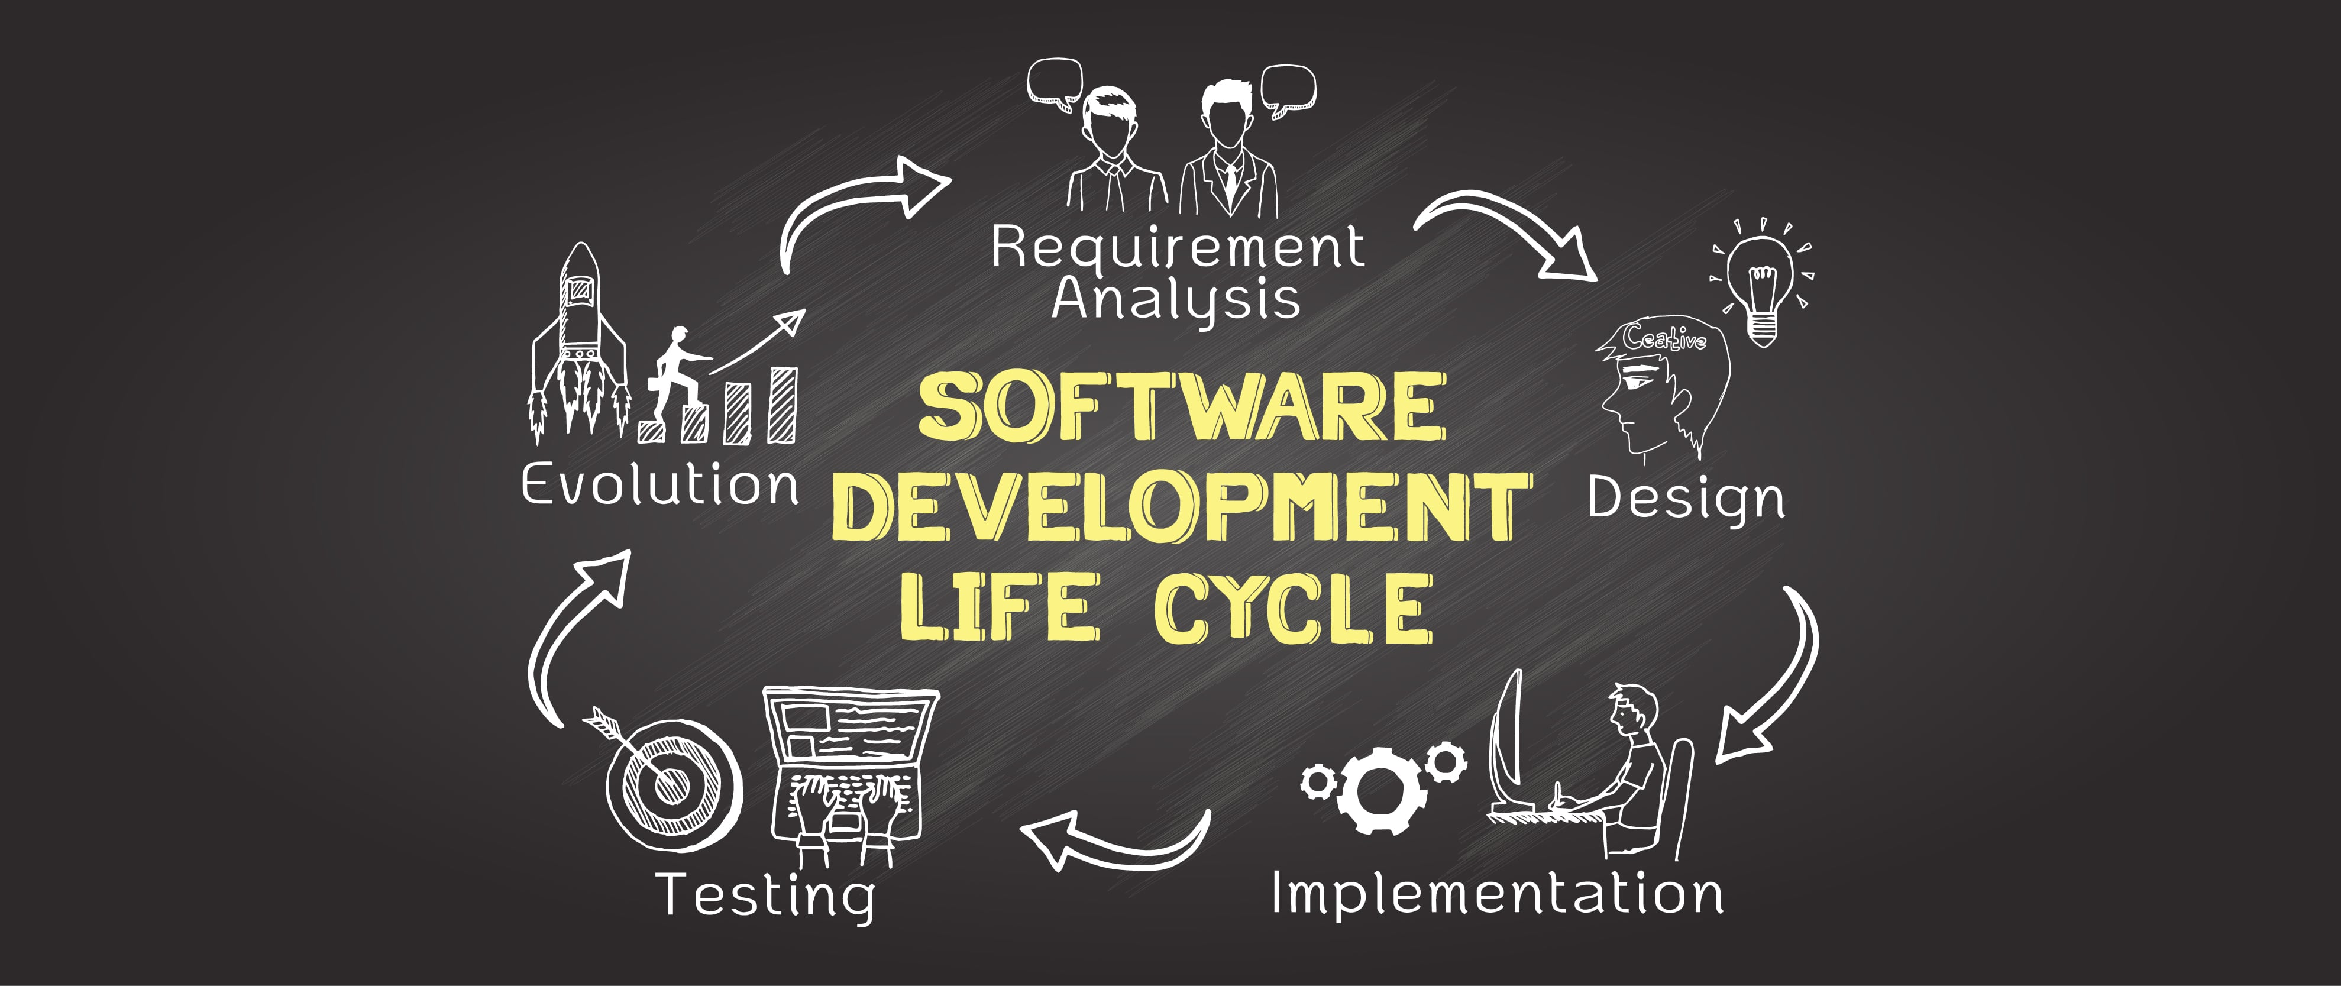
What is A Software Life cycle
The software-development life-cycle (SDLC) is used to facilitate the development of a large software product in a systematic, well-defined, and cost-effective way. An information system goes through a series of phases from conception to implementation. This process is called the Software-Development Life-Cycle.

Slide 3
Goal of the Software cycle
The goals of this SDLC approach are to: Deliver quality systems which meet or exceed customer expectations when promised and within cost estimates.

Slide 4
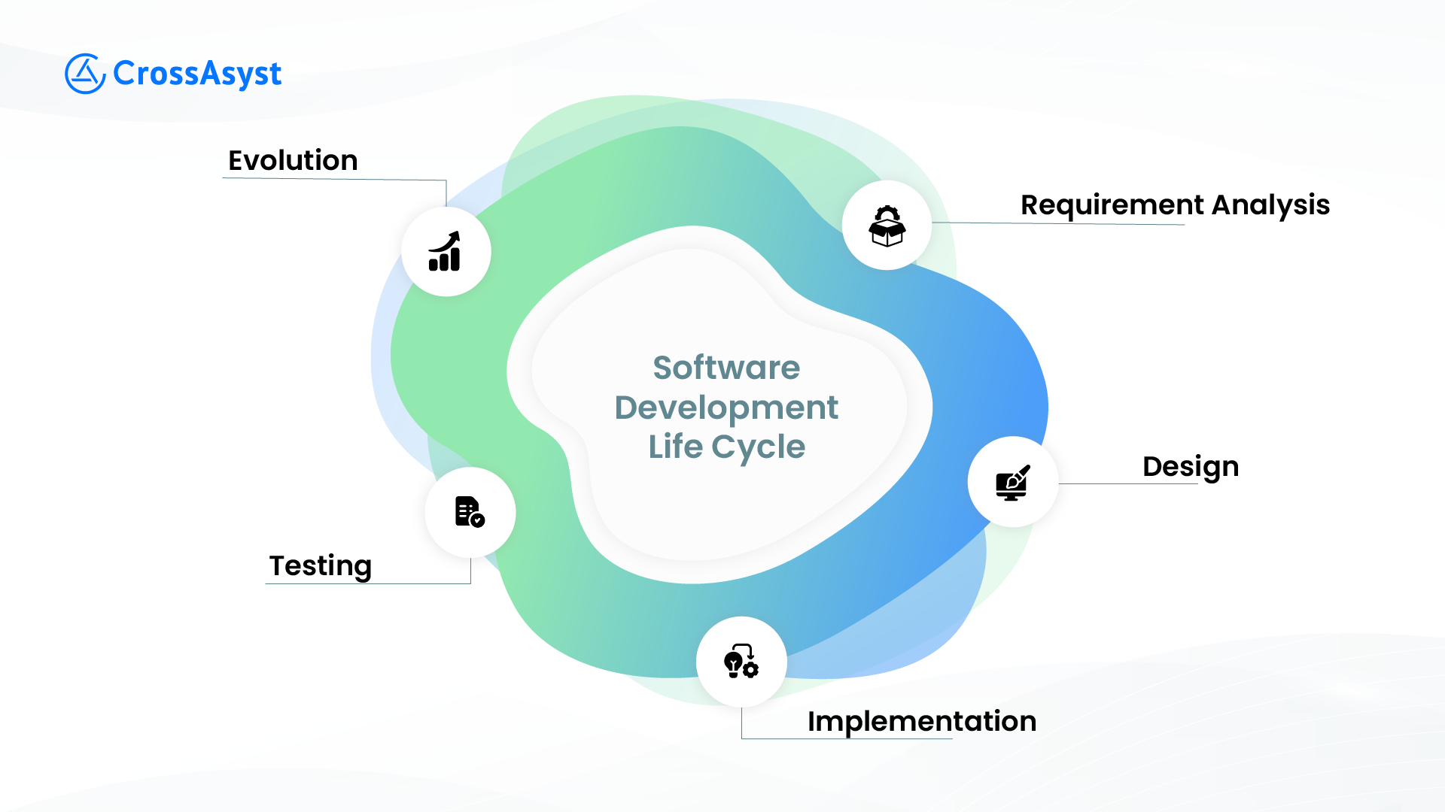

Slide 5
Requirements Analysis - is to specify what services the proposed system will provide to identify any conditions (time constraints, security…) on those services and to define how the outside world will interact with the system.
Design - Whereas requirements analysis provides a description of the proposed software product, design involves creating a plan for the construction of the proposed system. In a sense, requirements analysis is about identifying the problem to be solved, while design is about developing a solution to the problem.
Implementation - Implementation involves the actual writing of programs, creation of data files, and development of databases. It is at the implementation stage that we see the distinction between the tasks of a software analyst (sometimes referred to as a system analyst) and a programmer.
Testing-the process of debugging programs and confirming that the final software product was compatible with the software requirements specification.

Slide 6


